Slide 1
App for Event Management System
Submitted by:
Mr. Patil Pratik Kumar
Mr. Kare Abhilash Sudam
Mr. Pawar Vivek Appaso
Guided by: Mrs. Gaikwad K K

Slide 2
Introduction
Event management is the application of project management to the creation and development of large-scale events such as festivals, conferences, ceremonies, weddings, formal parties, concerts, or conventions.
In this project we have implemented Event Management System using Android Language and develop the android application.
The app consists of a database connectivity.
The application consists of different activities such as AddVender, AdminActivity, ListAll_Event_Register_Activity, ListAllVendorActivity, ListUserAllActivity.

Slide 3
Aim Of the Project
To analyze working of Event Management System.
To address importance of Android Language.
To study Android Language.
To implement App for Event Management System using Android.

Slide 4
Literature Review
Author (Publication) | Contribution | Conclusion
Jianye Liu, Jiankun Yu(IEEE Xplore) | This paper consisted of the information about digital Android Programming. | We used this paper to understand the concept of Android Programming.
N Verma (Ri Publications) | This paper explains the features of Android Studio. | We used this paper to understand features of Android Studio.
Jawed Ahmed(Journal of Telecommunication) | This paper explains importance of Android. | We used this paper to understand the applications of Android.
Amir Saleem (IJCSMC) | This research paper contained information about Event Manager and its implementation. | We used this paper to study the Event manger and its implementation using Android.
Kishore Baktha (IJCSMC) | This research paper includes all guidelines for successful creation of Mobile App. | We used this paper to study all guidelines or successful creation of Mobile app.

Slide 5
Files included in Project
XML files
activity_main.xml
activity_display_event_now.xml
activity_event_displayer.xml
event_item.xml
Java files
MainActivity.java
DisplayEventNowActivity.java
EventDisplayerActivity.java
OnEventClickListener.java

Slide 6
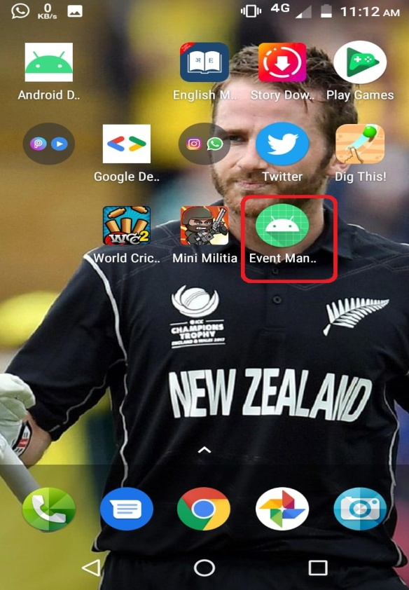
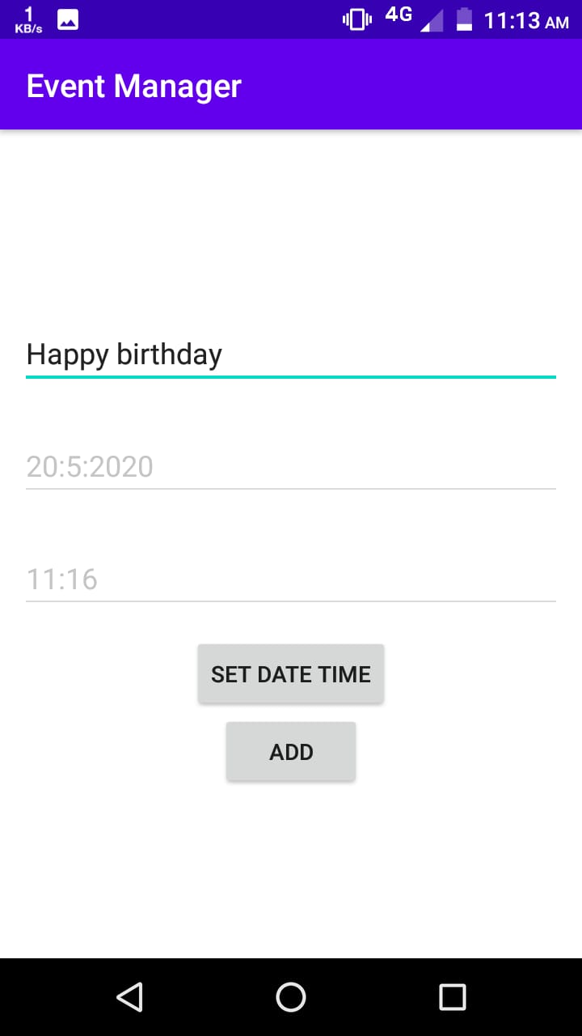
Snapshots of Output
Fig1. App with its icon
Fig2. Setting of Event

Slide 7
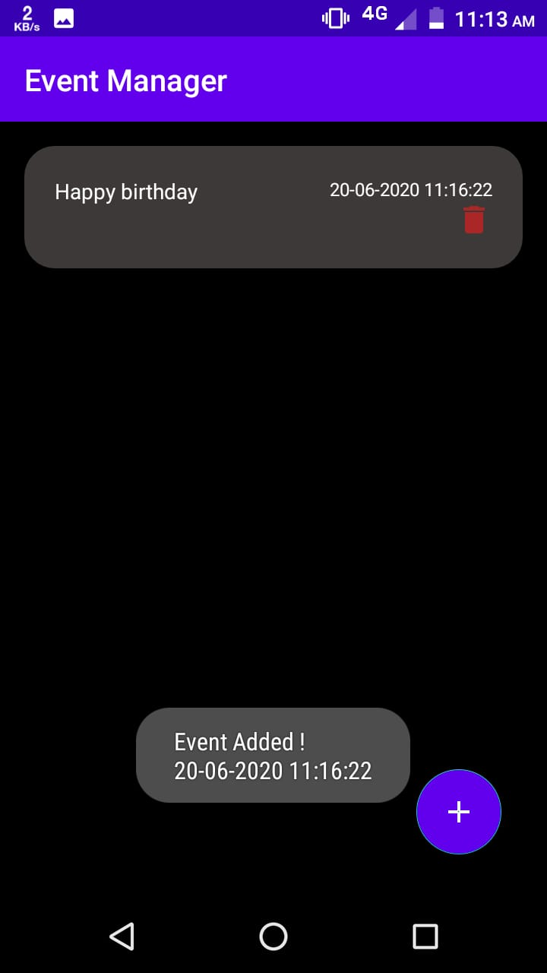
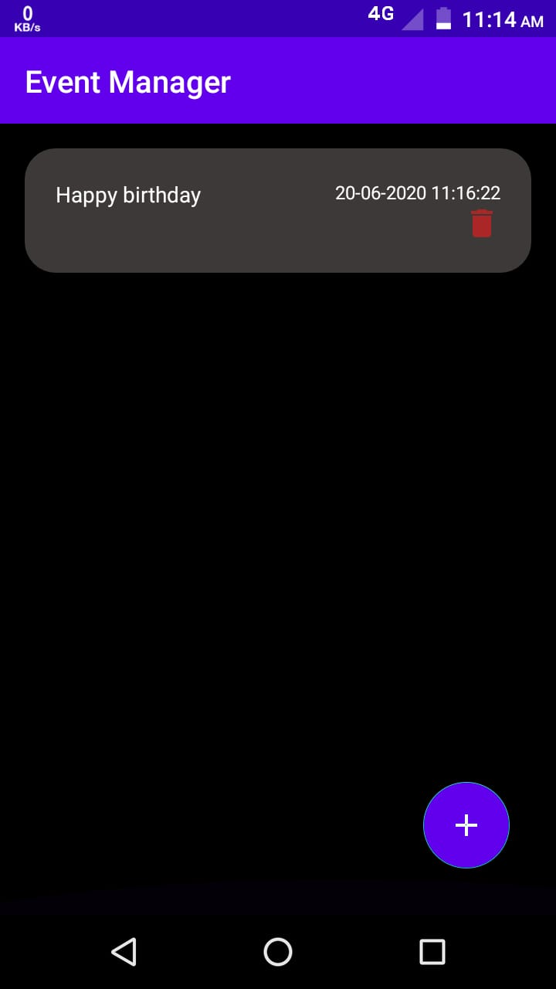
Snapshots of Output
Fig3. Message displayed after adding Event
Fig4. Activity displaying the Event

Slide 8
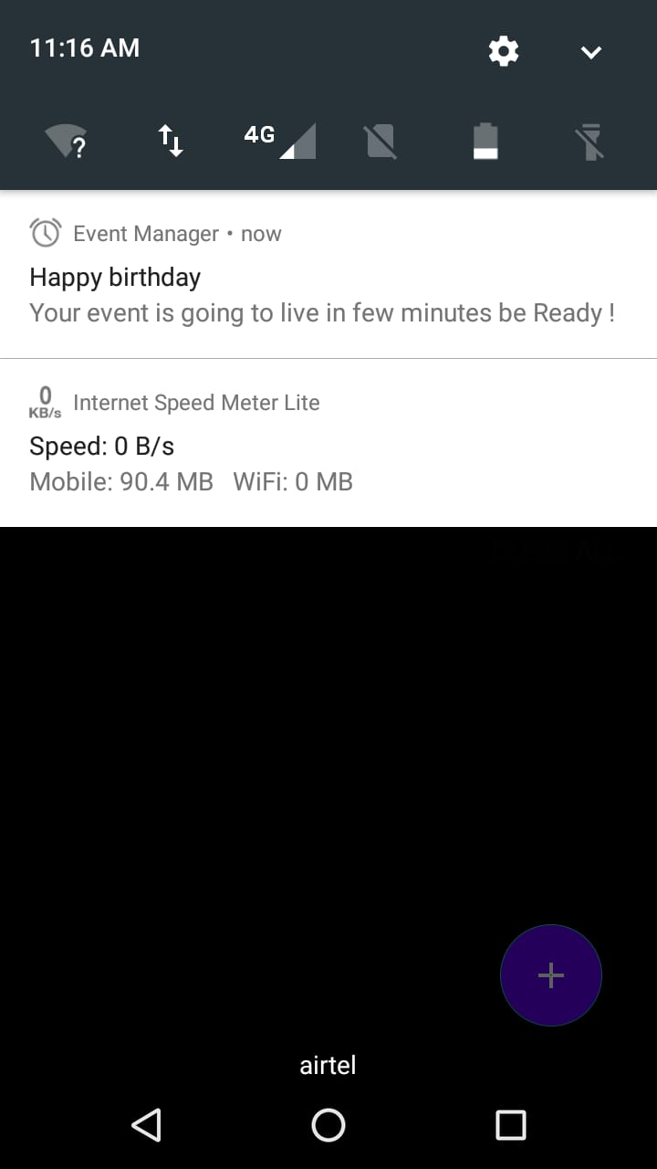
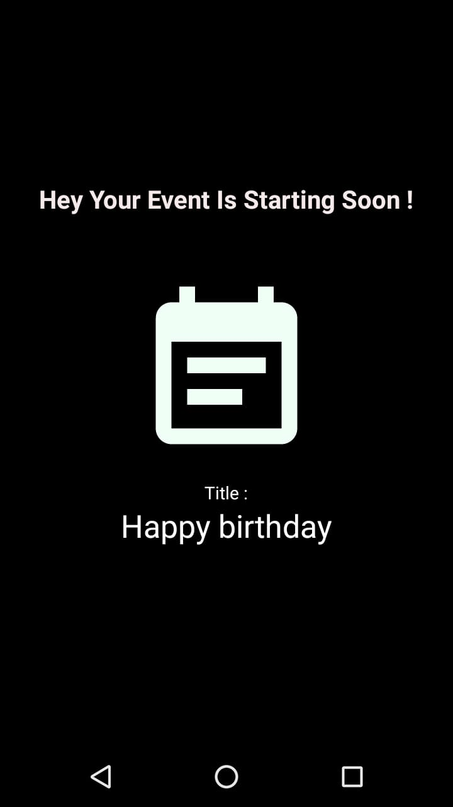
Snapshots of Output
Fig5. Notification shown before Event
Fig6. Activity shown just before Event

Slide 9
Skills Developed
Analyzing real world applications using Android Language.
Importance of Android application development.
Developing Event Management System with database connectivity.
Efficient communication skills.
Working as a team.
Developing leadership qualities

Slide 10
Applications
This project can be used in the implementation of User Interface components for android application development.
The project can be also used to understand the concept of features of Android Operating System.
The project can be used in learning and developing Android Applications

Slide 11
Thank You…
Any Queries ?

